Slide 1
08: POINTERS

Slide 2
1- Getting the Address of a Variable

Slide 3
Addresses and Pointers
Address:
  A uniquely defined memory location which is assigned to a variable.
  Example - a positive integer value
<An analogy with post box>
Post office box number 78 | Individual name John Ruiz | Contents Catalog
Memory Address 66572 | Identifier X | Contents 105

Slide 4
Notation for Memory Snapshot
Memory Address | Identifier | Contents
66572 | X | 105
Memory Address
66572
Contents
105
Identifier
X

Slide 5
Getting the Address of a Variable
Each variable in program is stored at a unique address
Use address operator & to get address of a variable:
  int num = -99;
  cout << &num; // prints address
  // in hexadecimal

Slide 6
Example 1
#include <iostream>
using namespace std;
int main()
{
int x=25;
cout<<"The address of x is= "<<&x<<endl;
cout<<"The value in x is "<< x<<endl;
}

Slide 7
Result of Example 1
x
25
The address of x is 0x8f05
The value in x is 25;

Slide 8
Exercise 1
Type & execute the following program
Check with your friend the address displayed.
#include <iostream>
using namespace std;
int main()
{
int x=25;
cout<<"The address of x is= "<<&x<<endl;
cout<<"The value in x is "<< x<<endl;
}

Slide 9
2 - Pointer Variables

Slide 10
Pointer Variables
Pointer variable : Often just called a pointer, it's a variable that holds an address
Because a pointer variable holds the address of another piece of data, it "points" to the data
Pointer variables are yet another way using a memory address to work with a piece of data.
This means you are responsible for finding the address you want to store in the pointer and correctly using it.

Slide 11
Pointer Variables (cont.)
Definition:
  int *intptr;
Read as:
“intptr can hold the address of an int”
Spacing in definition does not matter:
  int * intptr; // same as above
  int* intptr; // same as above

Slide 12
Pointer Variables (cont.)
Assigning an address to a pointer variable:
  int *intptr;
  intptr = &num;
Memory layout:
num
intptr
25
0x4a00
address of num: 0x4a00

Slide 13
Pointer Variables (cont.)
or
int a, b, *ptr;
ptr = &a;
int a, b, *ptr = &a;
ptr
a
0
b
0

Slide 14
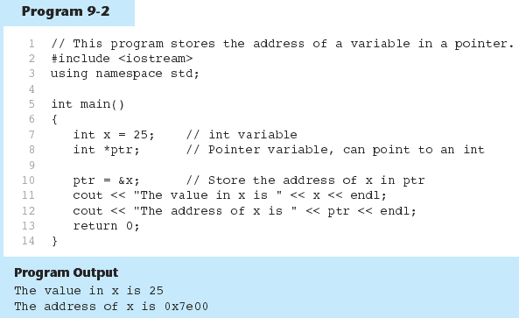
Example 2.1

Slide 15
The Indirection Operator
The indirection operator (*) dereferences a pointer.
It allows you to access the item that the pointer points to.
int x = 25;
int *intptr = &x;
cout << *intptr << endl;
This prints 25.

Slide 16
Pointer Variables (cont.)
int a = 5, b = 9,
*ptr = &a;
b = *ptr;
ptr
a
5
b
9
ptr
a
5
b
5
b=*ptr : b is assigned the value pointed to by ptr

Slide 17
Pointer Variables (cont.)
ptr
int a = 5, b = 9, *ptr = &a;
*ptr = b;
a
5
b
9
ptr
a
9
b
9
*ptr = b: the value pointed to by ptr is assigned the value in b.

Slide 18
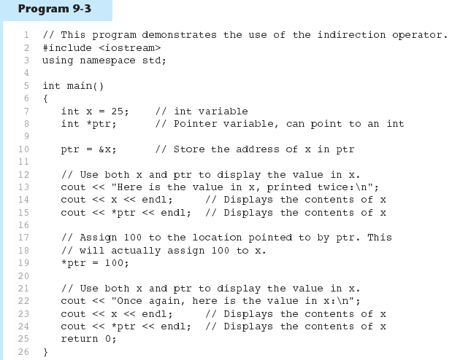
Example 2.2

Slide 19
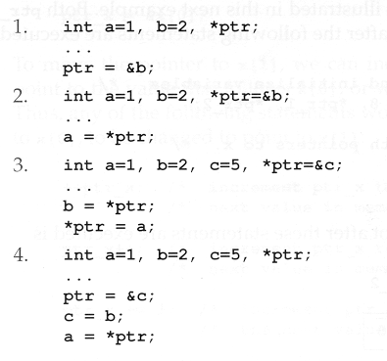
Exercise 2
Give memory snapshots after each of these sets of statements are executed.

Slide 20
Something like Pointers: Arrays
We have already worked with something similar to pointers, when we learned to pass arrays as arguments to functions.
For example, suppose we use this statement to pass the array numbers to the showValues function:
showValues(numbers, SIZE);

Slide 21
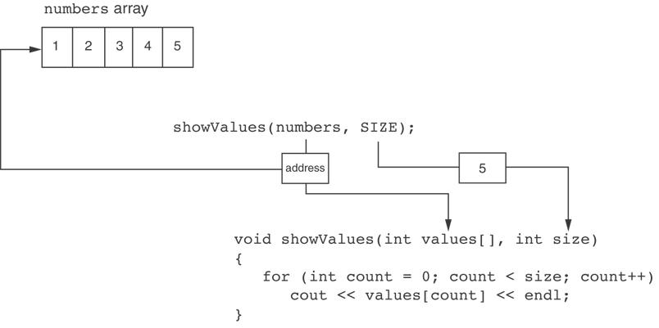
Something like Pointers: Arrays
The values parameter, in the showValues function, points to the numbers array.
C++ automatically stores the address of numbers in the values parameter.

Slide 22
Something like Pointers: Reference Variables
We have also worked with something like pointers when we learned to use reference variables.
Suppose we have this function:
void getOrder(int &donuts)
{
cout << "How many doughnuts do you want? ";
cin >> donuts;
}
And we call it with this code:
int jellyDonuts;
getOrder(jellyDonuts);

Slide 23
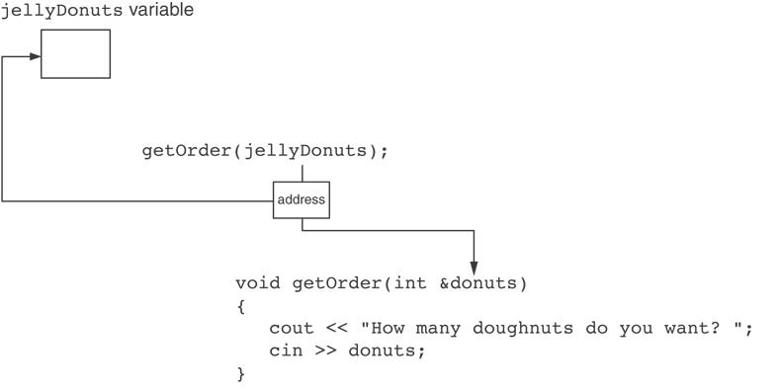
Something like Pointers: Reference Variables
The donuts parameter, in the getOrder function, points to the jellyDonuts variable.
C++ automatically stores the address of jellyDonuts in the donuts parameter.

Slide 24
3 - The Relationship Between Arrays and Pointers

Slide 25
The Relationship Between
Arrays and Pointers
Array name is starting address of array
  int vals[] = {4, 7, 11};
  starting address of vals: 0x4a00
  cout << vals; // displays 0x4a00
  cout << vals[0]; // displays 4
4 | 7 | 11

Slide 26
The Relationship Between
Arrays and Pointers
int x[5], *ptr_x;
ptr_x = &x[0];
ptr_x
Memory allocation
?
?
?
?
?
x[0]
x[1]
x[2]
x[3]
x[4]
The memory location for x[1] is immediately follow the memory location of x[0].

Slide 27
The Relationship Between
Arrays and Pointers (cont.)
Array name can be used as a pointer constant:
  int vals[] = {4, 7, 11};
  cout << *vals; // displays 4
Pointer can be used as an array name:
  int *valptr = vals;
  cout << valptr[1]; // displays 7

Slide 28
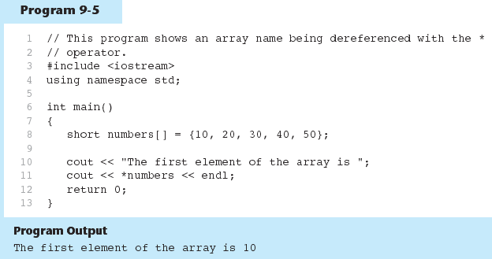
Example 3

Slide 29
Exercise 4
Refer to previous slide in Program 9-5.
Print the third element in the array using pointer number.

Slide 30
4 - Pointers Arithmetic

Slide 31
Pointers Arithmetic
Operations on pointer variables:
Operation | Example int vals[]={4,7,11}; int *valptr = vals;
++, -- | valptr++; // points at 7 valptr--; // now points at 4
+, - (pointer and int) | cout << *(valptr + 2); // 11
+=, -= (pointer and int) | valptr = vals; // points at 4 valptr += 2; // points at 11
- (pointer from pointer) | cout << valptr–val; // difference //(number of ints) between valptr // and val

Slide 32
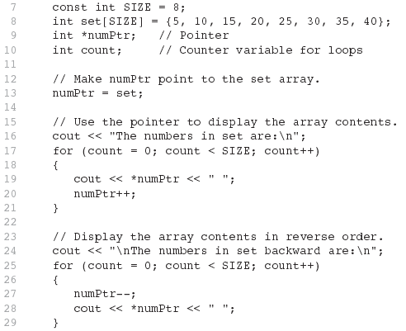
Example 4

Slide 33
Pointers in Expressions
Given:
  int vals[]={4,7,11}, *valptr;
  valptr = vals;
What is valptr + 1? It means (address in valptr) + (1 * size of an int)
  cout << *(valptr+1); //displays 7
  cout << *(valptr+2); //displays 11
Must use ( ) as shown in the expressions

Slide 34
Pointers in Expressions
depends on the machine used
depends on the variable type
For examples,
  Short integers ( 2 byte )
    Beginning : ptr = 45530
    After ptr++ : ptr = 45532
  Floating point values ( 4 byte )
    Beginning : ptr = 50200
    After ptr++ : ptr = 50204

Slide 35
Array Access
Array elements can be accessed in many ways:
Array access method | Example
array name and [] | vals[2] = 17;
pointer to array and [] | valptr[2] = 17;
array name and subscript arithmetic | *(vals + 2) = 17;
pointer to array and subscript arithmetic | *(valptr + 2) = 17;

Slide 36
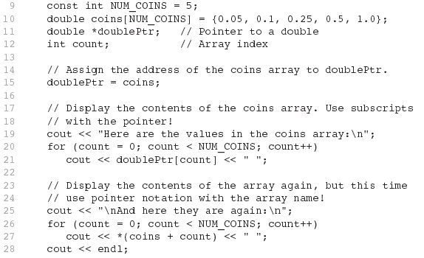
Array Access

Slide 37
5 - Initializing Pointers

Slide 38
Initializing Pointers
Can initialize at definition time:
  int num, *numptr = &num;
  int val[3], *valptr = val;
Cannot mix data types:
  double cost;
  int *ptr = &cost; // won’t work
Can test for an invalid address for ptr with:
  if (!ptr) ...

Slide 39
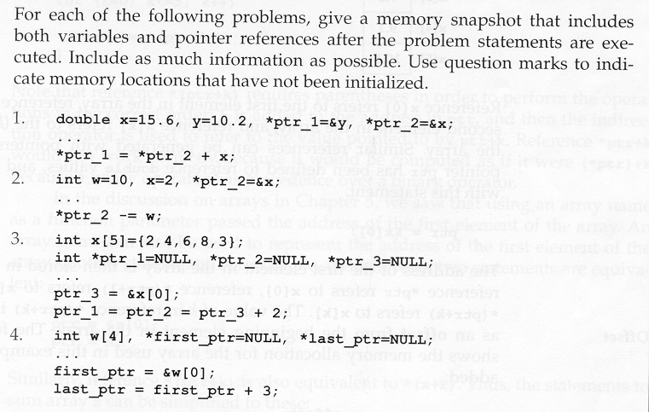
Exercise 6

Slide 40
6 - Comparing Pointers

Slide 41
Comparing Pointers
Relational operators (<, >=, etc.) can be used to compare addresses in pointers
Comparing addresses in pointers is not the same as comparing contents pointed at by pointers:
  if (ptr1 == ptr2) // compares
  // addresses
  if (*ptr1 == *ptr2) // compares
  // contents

Slide 42
Exercise 7
#include <iostream>
using namespace std;
int main()
{
int value=7;
int *ptr1 = &value;
int *ptr2 = &value;
if (ptr1==ptr2){
cout << ”Pointers are Equal”;
}else{
cout << "Pointers are Not Equal”;}
return 0;
}
Pointers are Equal

Slide 43
7 - Pointers as Function Parameters

Slide 44
Pointers as Function Parameters
A pointer can be a parameter
implements call-by-address references
allows to modify the values by statements within a called function
Requires:
  asterisk * on parameter in prototype and heading
  void getNum(int *ptr); // ptr is pointer to int
  asterisk * in body to dereference the pointer
cin >> *ptr;
  address as argument to the function
  getNum(&num); // pass address of num to getNum

Slide 45
Example 7.1
void swap(int *x, int *y)
{ int temp;
temp = *x;
*x = *y;
*y = temp;
}
int num1 = 2, num2 = -3;
swap(&num1, &num2);

Slide 46
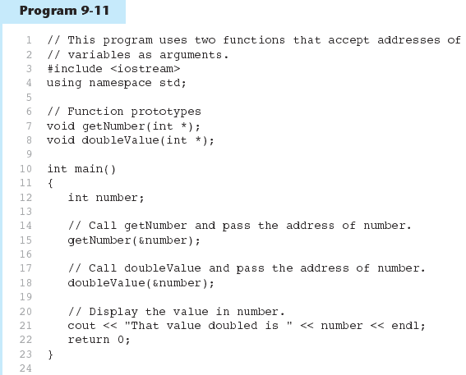
Example 7.2

Slide 47
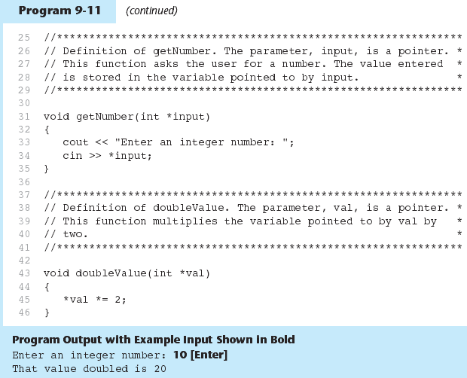
Example 7.2 (cont.)

Slide 48
Pointers to Constants
If we want to store the address of a constant in a pointer, then we need to store it in a pointer-to-const.
Example: Suppose we have the following definitions:
const int SIZE = 6;
const double payRates[SIZE] =
{ 18.55, 17.45, 12.85,
14.97, 10.35, 18.89 };
In this code, payRates is an array of constant doubles.

Slide 49
Pointers to Constants
Suppose we wish to pass the payRates array to a function? Here's an example of how we can do it.
void displayPayRates(const double *rates, int size)
{
for (int count = 0; count < size; count++)
{
cout << "Pay rate for employee " << (count + 1)
<< " is $" << *(rates + count) << endl;
}
}
The parameter, rates, is a pointer to const double.

Slide 50
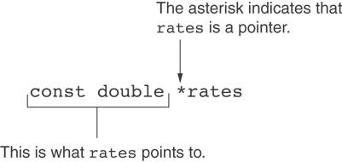
Declaration of a
Pointer to Constant

Slide 51
Constant Pointer
A constant pointer is a pointer that is initialized with an address, and cannot point to anything else.
Example
int value = 22;
int * const ptr = &value;

Slide 52
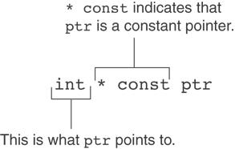
Declaration of a
Constant Pointers

Slide 53
Declaration of a
Constant Pointers

Slide 54
Constant Pointer to Constants
A constant pointer to a constant is:
  a pointer that points to a constant
  a pointer that cannot point to anything except what it is pointing to
Example:
int value = 22;
const int * const ptr = &value;

Slide 55
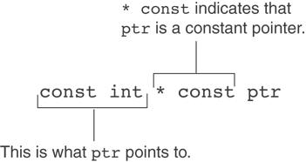
Constant Pointer to Constants

Slide 56
8 - Dynamic Memory Allocation

Slide 57
Dynamic Memory Allocation
Can allocate storage for a variable while program is running
Computer returns address of newly allocated variable
Uses new operator to allocate memory:
  double *dptr;
  dptr = new double;
new returns address of memory location

Slide 58
Dynamic Memory Allocation
Can also use new to allocate array:
const int SIZE = 25;
arrayptr = new double[SIZE];
Can then use [] or pointer arithmetic to access array:
  for(i = 0; i < SIZE; i++)
  arrayptr[i] = i * i;
  or
  for(i = 0; i < SIZE; i++)
  *(arrayptr + i) = i * i;
Program will terminate if not enough memory available to allocate

Slide 59
Releasing Dynamic Memory
Use delete to free dynamic memory:
  delete fptr;
Use [] to free dynamic array:
  delete [] arrayptr;
Only use delete with dynamic memory!

Slide 60
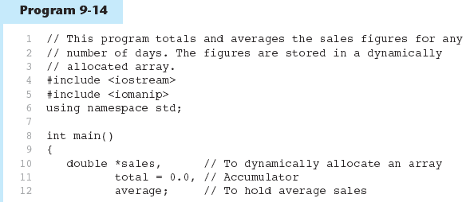
Example 8

Slide 61
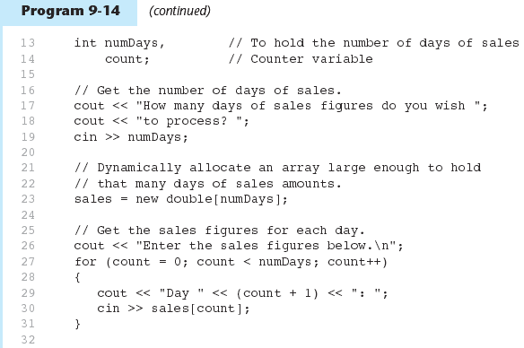
Example 8 (cont.)

Slide 62
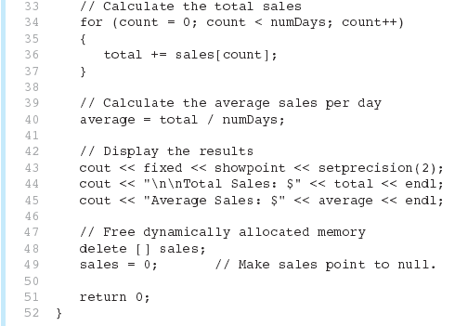
Example 8 (cont.)

Slide 63
Exercise 9
Given the following program with 3 errors. Rewrite the program to store the power value of the array’s index and print the values.
int main(){
const int SIZE = 25;
int *arrayptr;
arrayptr = new double[SIZE];
for(int i = 0; i < SIZE; i++)
*arrayptr[i] = i * i;
for(int i = 0; i < SIZE; i++)
cout <<*arrayptr + i<<endl;
return 0;
}

Slide 64
9 - Returning Pointers from Functions

Slide 65
Returning Pointers from Functions
Pointer can be the return type of a function:
  int* newNum();
The function must not return a pointer to a local variable in the function.
A function should only return a pointer:
  to data that was passed to the function as an argument, or
  to dynamically allocated memory

Slide 66
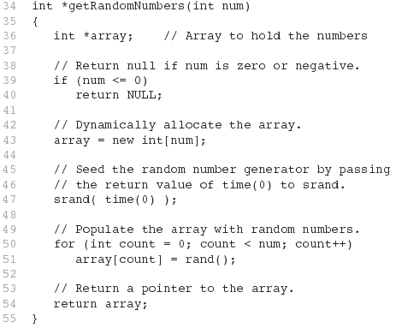
Example 9

